Slide 1

Educational Career Action Plan
YOU’RE CAREER STARTS NOW !!!!
Everyone NEEDS one !

Slide 2

What is an ECAP?
Educational Career Action Plan is a plan to assist you in selecting a career based upon you interests, skills, aptitudes and talents. It’s a map to get you to your destination. The “GPS” system we use is AZCIS.
AZCIS Provides:
Provide Potential Careers based upon skills and likes and dislikes.
Give Accurate Information on careers both locally and nationally.
Scholarship Sort
College information
Skills Assessments
Resume

Slide 3

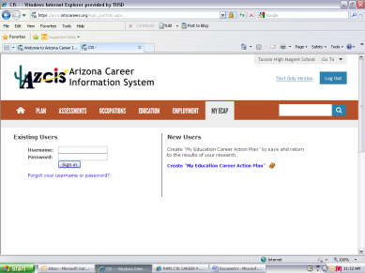
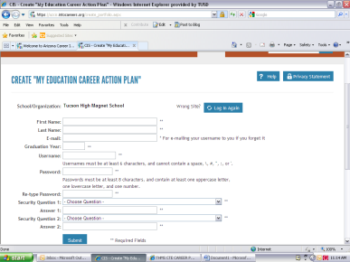
Creating an Account or Login to Existing Account
Log in to the site:
Website: www.azcis.intocareers.org
Username: tucsonhms
Password: 4azcis02
Log in to your own account (Very Important!!!)
Create your own ECAP (Educational Career Action Plan) OR login to existing account

Slide 4
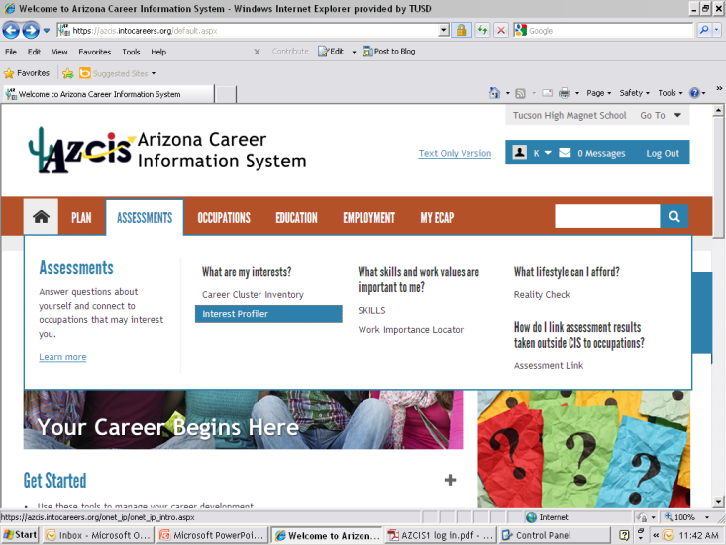
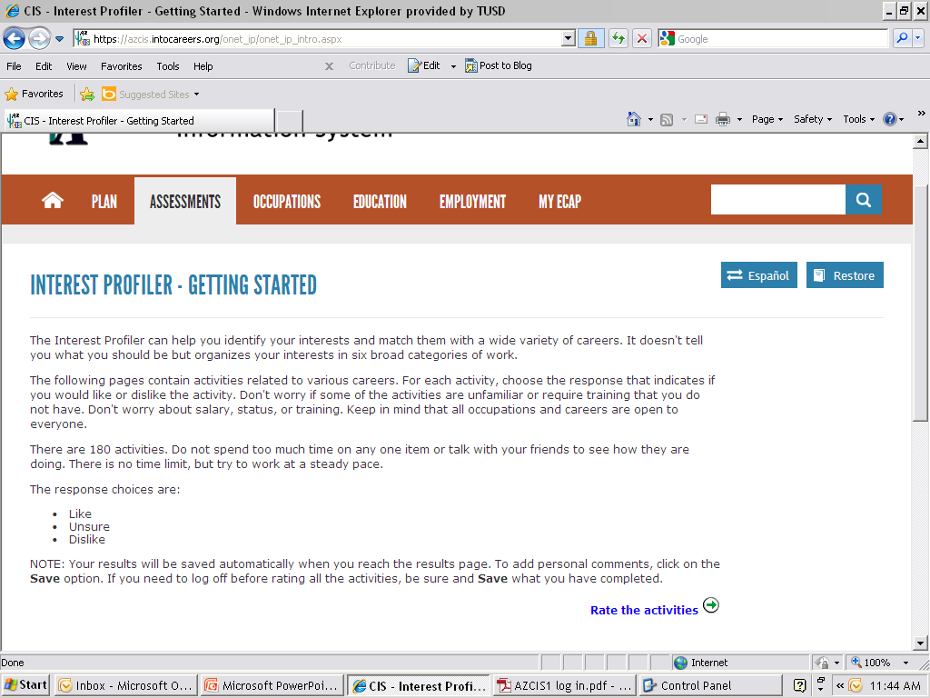
Activity 1: Interest Profiler
Click on the Assessments tab >then Interest Profiler.
Read the description below and rate the following activities

Slide 5
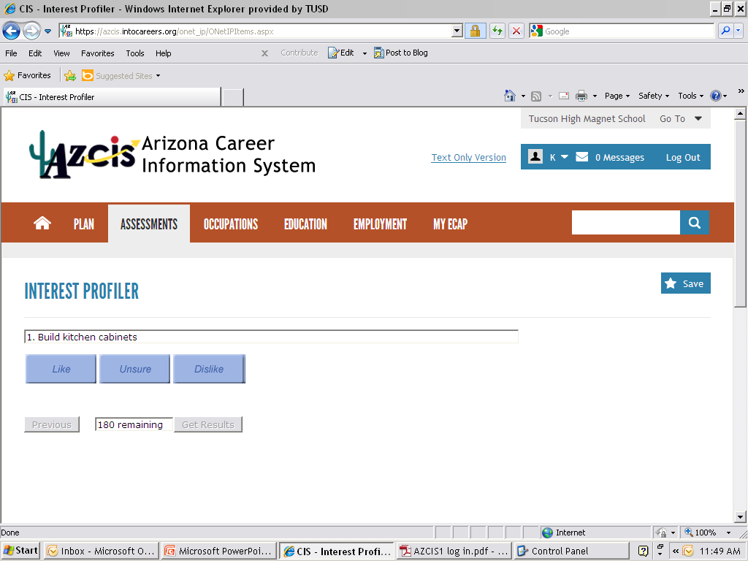
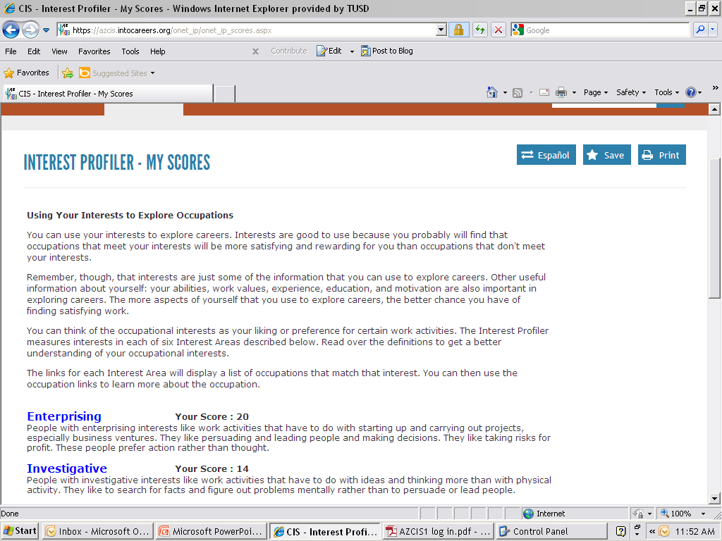
Activity 1: Interest Profiler
Decide which of these activities you would enjoy doing or would want to participate in as a gauge to see what your likes are - THEY ARE NOT ASKING IF YOU WANT TO CHOP WOOD AS A CAREER!
You will get your results as to the personality type. Make sure to SAVE your results or you wont get credit. Click on each personality type and search to see which careers are best matched to your interests.

Slide 6
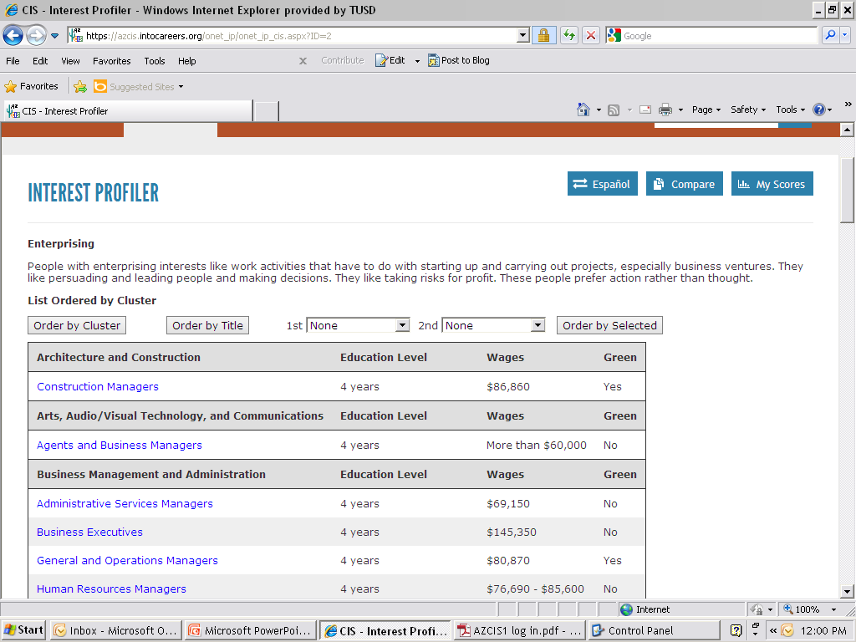
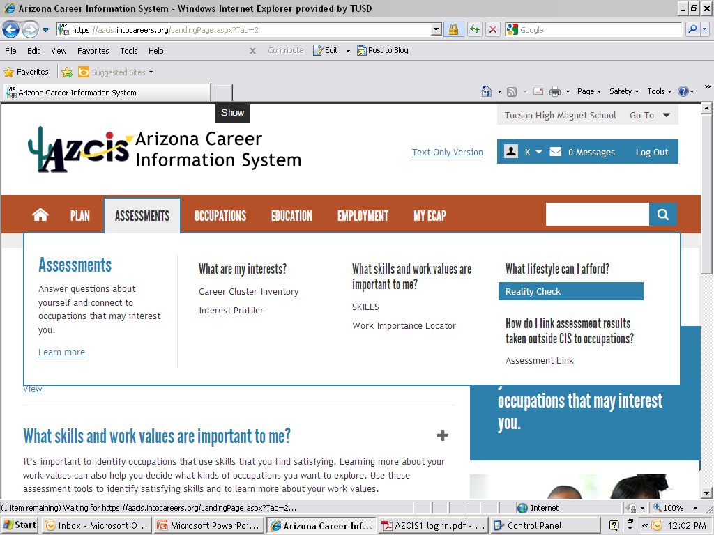
Activity 2: Reality Check
You can see which careers match your interest and what those careers pay and the level of education needed.
Click on Assessments tab again and find Reality Check to the far right.

Slide 7
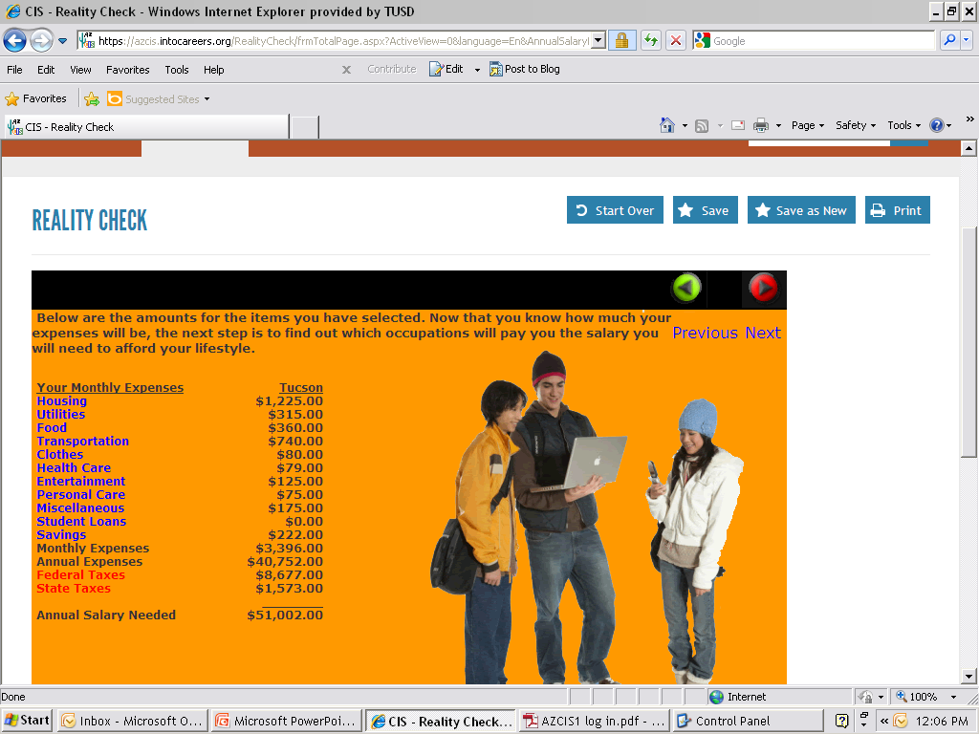
Activity 2: Reality Check Continued
Select the answers that apply best to you personally and at the end you will end up with an estimate for what they will need to earn based upon their living criteria.
YOU must SAVE
You must save after each activity to receive credit.
This PowerPoint is available on the:
Career Website
Career Center T146
Hard Copy Handouts.

Slide 8

Future Activities
School Sort- (College and Technical Options)
Workplace Importance Locator
Scholarship Sort- (Scholarships for College)
Skills Assessment- (Holland Code/Skill Listing)

